Slide 1

Capture The Flag (CTF)
NAME: Micah Martinez
Team Name: Cinco

Slide 2

Introduction
The CTF Problem
Steps to Solve
The Solution
Workplace Relevance
Notes:
Tell your audience what you intend to cover in your project. This is the purpose of your communication.
In Section 1, provide some background of the category of your CTF challenge.
Introduce the audience to the problem and tell us how you plan to approach it and get the solution.
In Section 2, cover the steps you used to solve the problem. This may cover multiple solves.
In Section 3, talk about how you found the solution and discuss the pitfalls and recommendations when facing these types of problems.
In Section 4, talk about the relevance of Capture the Flag problems to the workplace and your job role.

Slide 3
CTF Category Description
Category 3 – Forensics-Hard Disks
Category 3 of the CTF challenges involve using registry or image files to find information. The challenge I attempted involved finding the version number of Opera within the registry files.
It is important to know how to read the registry files as well as where to look in order to find the version number of specific software.
This category relates to the Ethical Hacking course because of what you can do after gaining access to a system. If you can access the registry file, you can use the registry files to look for old software or other applications that you know have vulnerabilities and then exploit these to escalate your privileges or gain different information.
Notes:
Before presenting this problem, discuss the category of the CTF challenge and the relevant skills needed to solve this type of problem.
Answer the four questions below in your slide and make these questions your talking points.
Describe the category of question that you attempted.
What is the important background knowledge needed?
How does this relate to the Ethical Hacking course?
What lab in the course covered the topic from this CTF problem?

Slide 4
What are registry files?
Central database used by Windows operating systems to store information that is necessary to configure the system (Microsoft, 2020).
May contain profile data for each user, applications installed on the computer, what hardware is used, and even ports that are used.
Can be accessed via the Registry Editor (regedit)

Slide 5
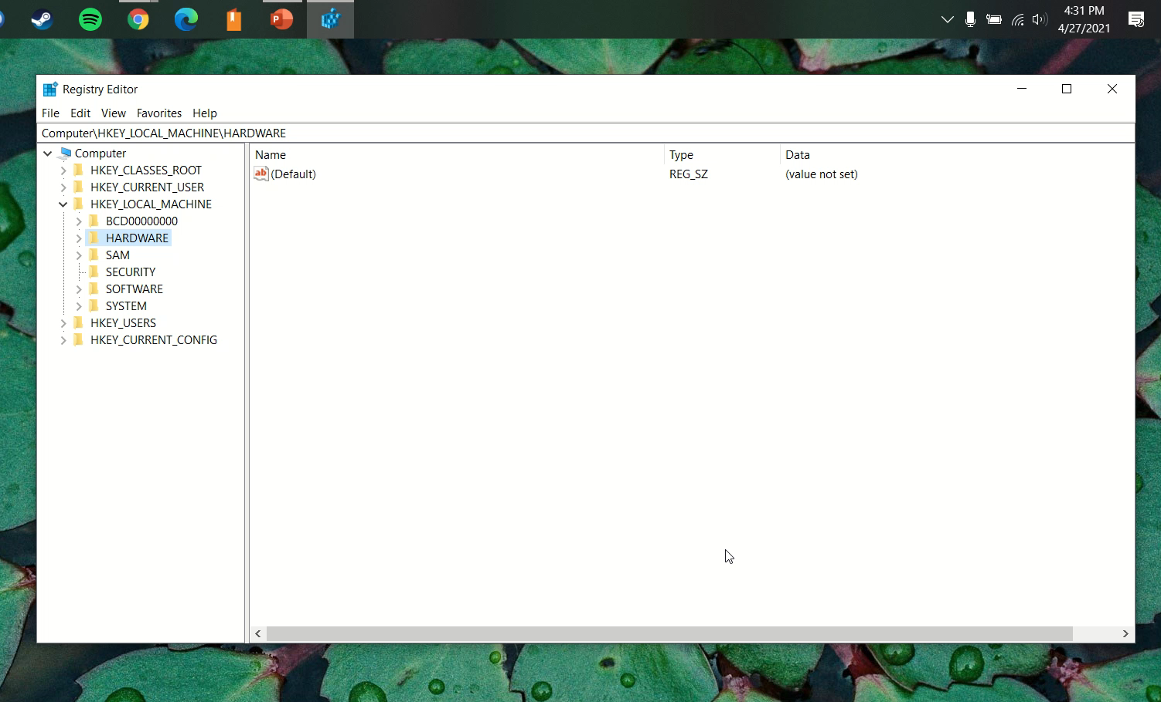
Finding the Solution
Notes:
Sample text for narration: Right-click one of the packet frames (below frame #71) and choose the Follow > TCP Stream to show the conversation between the FTP server and the client machine. Note: TCP is the Transmission Control Protocol, a connection-oriented protocol.
You may choose to add additional slides.

Slide 6
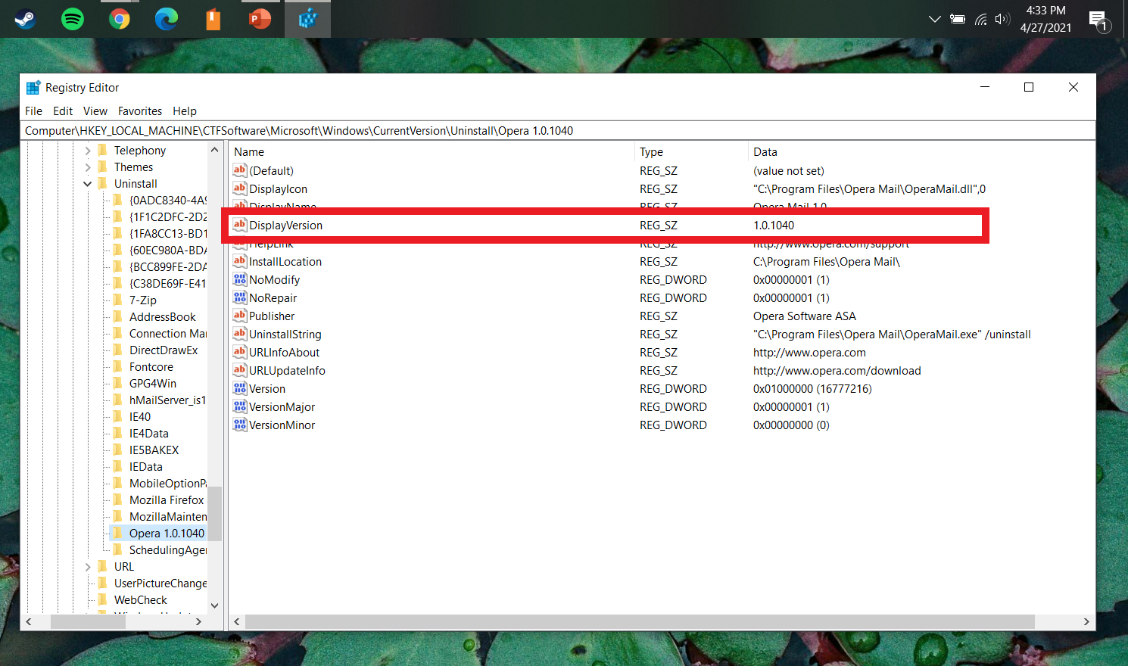
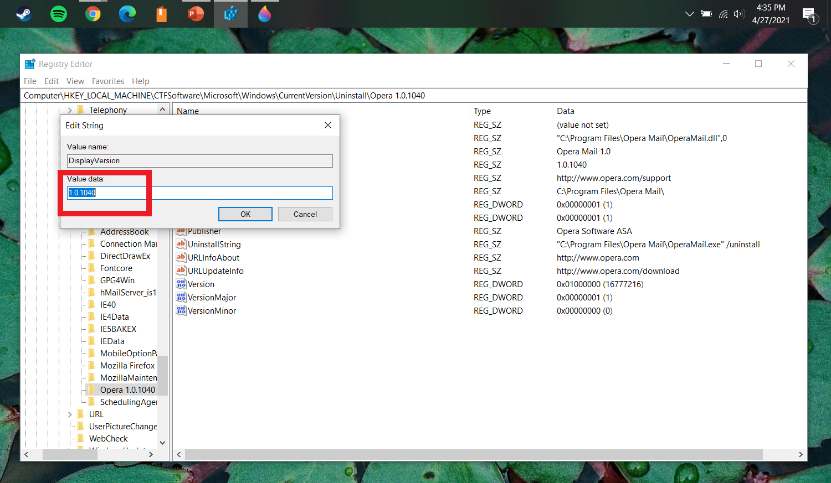
Finding the solution
There are two places where you can find the flag.
The first location is on the right-hand side in the data column, highlighted in the image below.
The second location is found by double clicking on “Display Version” which will bring up the “Edit String” box. Here you can find the flag.
Notes:
Sample text for narration: In the Follow TCP Stream pop-up window, search for the flag, in the format of UMGC-XXXXX (below, UMGC-ABC123).
Write out the flag in your documentation. Your screenshot of the Follow TCP Stream pop-up window must include the date/time from the host system. Each student is responsible for providing at least one screenshot as shown below.

Slide 7
Strategies, Pitfalls, Lessons Learned
Find out where the version is likely to be located.
After some research, I found a similar issue that included the file path to the version number (Xeo, 2014).
Make sure you are using the correct registry files.
The greatest issue I faced, was that I accidently used registry files from a previous CTF challenge. This meant that the flag was nonexistent until I used the correct files.
Notes:
In this section, discuss some of the strategies you used to solve your CTF problem, as well as some of the pitfalls that can lead to the wrong path. This will all be part of the lessons learned section that will help you know how to approach this kind of problem.

Slide 8
The Relationship to the Workplace
Learn new methods and strategies that might have gone unnoticed.
Learn new skills.
Gain experience in your line of work.
Notes:
In this section, discuss how you think Capture the Flag competitions can benefit you in the workplace.

Slide 9
Summary
Registry file are a vital part of a Windows machine.
Changing information in the registry file may cause significant changes and possibly severe damage.
Working on CTF Challenges and with a team can help increase experience, learn new skills, and assist in finding new solutions to various problems.
Notes:
This is your summary and your last opportunity to connect with your audience.
Do not merely repeat your agenda topics. Add one to two important details about each main point to review for your audience.
What is/are the main takeaway(s)?

Slide 10
References
Microsoft. (2020, September 08). Windows registry information for advanced users. Retrieved from Microsoft: https://docs.microsoft.com/en-us/troubleshoot/windows-server/performance/windows-registry-advanced-users
Xeo. (2014, February 19). How to get version number in registry and install new software using batch file? Retrieved from Stack Overflow: https://stackoverflow.com/questions/21879957/how-to-get-version-number-in-registry-and-install-new-software-using-batch-file
Notes:
The example above uses IEEE style. Ask your instructor for clarification on the style to be used.
A narration for this slide is not required.

